Slide 1
Business Writing I – Introduction
Martin Weisser weissermar@gmail.com

Slide 2
Outline
Introduction to the Course
What Is Business Writing?
What Are the Differences Between the Forms of Writing?
Formats & Forms of Business Writing
Brief Overview of Forms/Types Covered on the Course

Slide 3
Introduction to the Course
Aims:
Identify Important Characteristics and Types of Business Writing
Develop Successful Strategies for
Researching Information
Presenting Relevant Information Verbally & Visually
Presenting Information in a Semi-structured or Structured Manner
Presenting Information in Factual & Less Factual (‘Heged’) Language
Develop the Relevant Skills for Writing Business Documents Through Various Writing Activities
Improve Your Written Communication Skills in General

Slide 4
Assessment Ideas
negotiable, to some extent ;-)
scenario/theme-based development of a topic
business proposal
investigative report/feasibility study
incident report
progress report
two pieces of short writing assessed
final exam

Slide 5
Possible Scenarios/Themes
developing new features for mobile phones
launching a new product
creating an advertising strategy for a new product
setting up a new IT infrastructure for a large company
planning a company expansion

Slide 6
What Is Business Writing?
‘process’: ‘writing for business purposes’
‘product’: different types of written communication
between (potential) business partners
within a business
comprises various different activities/forms, generally including
memos
letters & emails
reports
etc.

Slide 7
What Are the Differences Between the Forms of Writing?
structure & organisation
length & number of sections
use of headers & headings
formal layout requirements
number of attachments/enclosures
levels of formality
etc.

Slide 8
Formats & Forms of Business Writing
formats (e.g. letter, email, memo, etc.) determined by
medium of transmission
conventions
purpose
forms/types (e.g. proposal, report, etc.) determined by
purpose
conventions
required level of formality
important: different forms may be presented in different formats!

Slide 9
Exercise 1
Look at the following examples carefully and see whether you can identify any typical characteristics regarding
content
format
presentation style
Keep notes on your observations
Is there anything they might have in common?

Slide 10
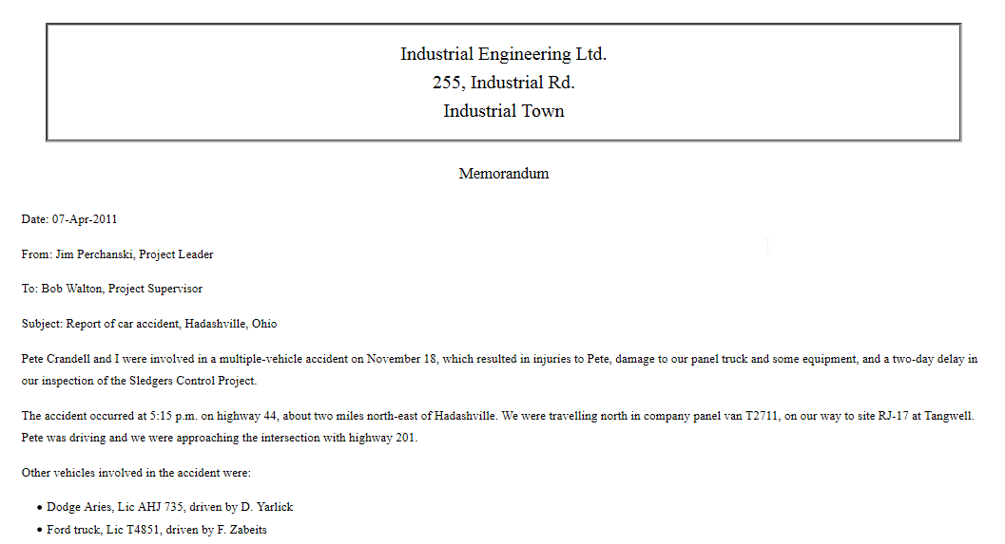
Formats – Memo Sample

Slide 11
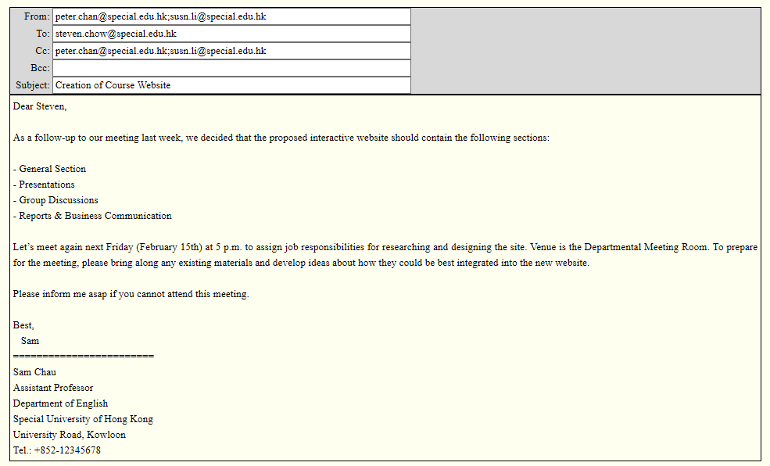
Formats – Email Sample

Slide 12
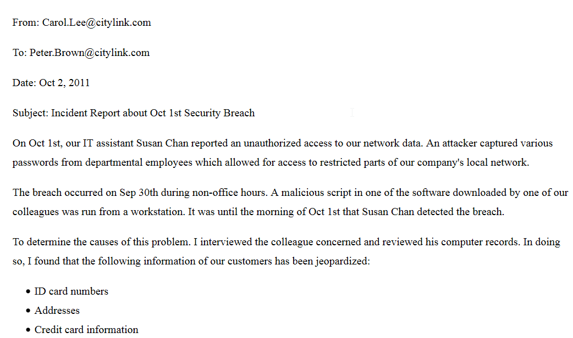
Formats – Short Report Sample

Slide 13
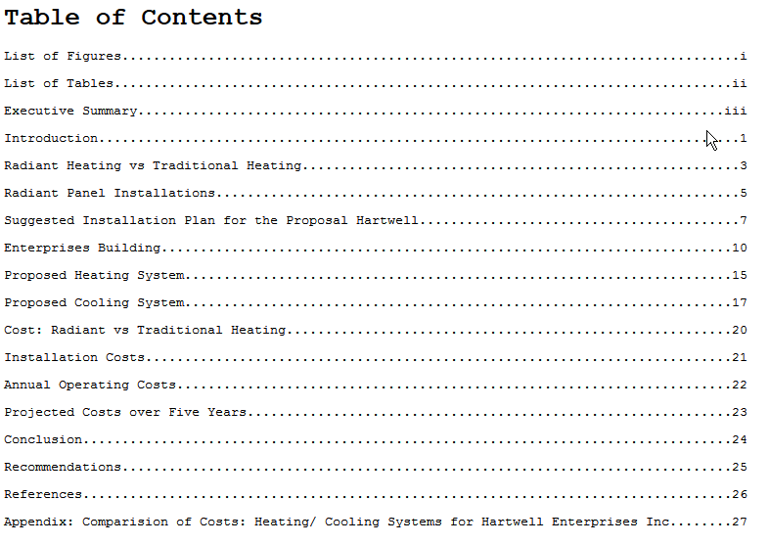
Formats – Long Report Sample (TOC)

Slide 14
Task 2
Think of any potential situations where these types of business writing may be useful.
Which situations or purposes can you identify?
Could any of these formats be useful for different purposes?

Slide 15
Brief Overview of Forms/Types Covered on the Course
proposals
suggest possible options for development/improvement
generally persuasive
reports
summarise or investigate facts, events/incidents
evaluate feasibility, progress
generally expository or justificatory

