Slide 1
ICEweb 2
a new way of compiling high-quality web-based components for ICE corpora
Martin Weisser
Center for Linguistics & Applied Linguistics, Guangdong University of Foreign Studies
weissermar@hotmail.com, http://martinweisser.org

Slide 2
Outline
motivation
methods & issues
background – ICEweb ver. 1
ICEweb ver. 2 – overview
details…

Slide 3
Methods & issues
creation of large-scale web corpora often done via seed terms and automated downloads
advantage
  easy way to generate masses of corpus data
disadvantages
  relative lack of control over results → ‘blind faith’
  need for sophisticated means of identifying duplicates & boilerplate removal
for smaller, more qualitative corpora, different (cyclical) approach better
  de-/re-fining seed terms
  visual inspection and selection of results
  download & editing

Slide 4
Motivation
new efforts to enhance/augment ICE corpora
own plans to carry out automated speech-act analysis on written data
larger variety of public and private texts available online
‘web scraping’ more convenient that other forms of procuring electronic texts, such as converting from word processing formats, PDFs, or scanning
some HTML markup useful in identifying structural elements, such as headings, etc., for more advanced corpus markup & processing

Slide 5
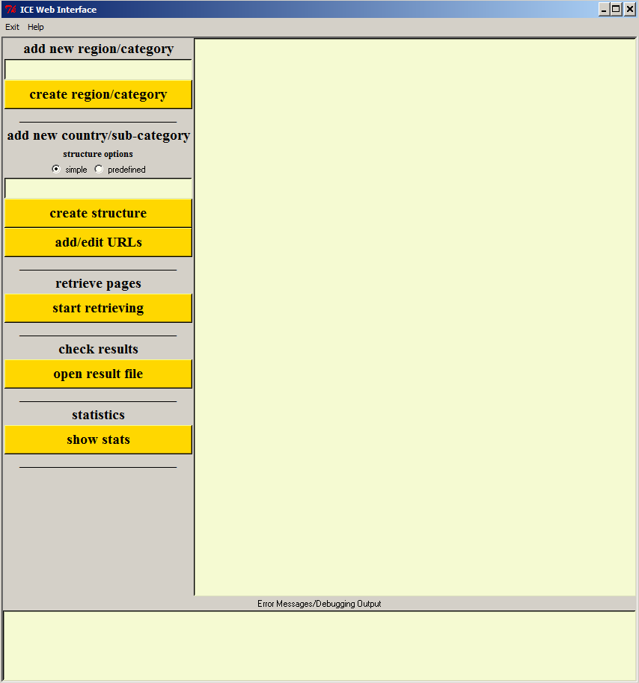
background – ICEweb ver. 1
created 2008, released in 2013
colourful ;-), but a few disadvantages
  not really designed around ICE categories
  relatively complex way of setting up data structures
  no support for seeding
  lack of user control over processing/data handling options

Slide 6
ICEweb ver. 2
includes original ICE categories, but can be augmented
more intuitive way of selecting regions/countries & categories
most relevant folders get created automatically
new, user configurable, options for setting defaults, etc., via conf file
processing steps separated
better HTML handling, including boilerplate removal
enhanced analysis features (n-grams & concordancing)

Slide 7
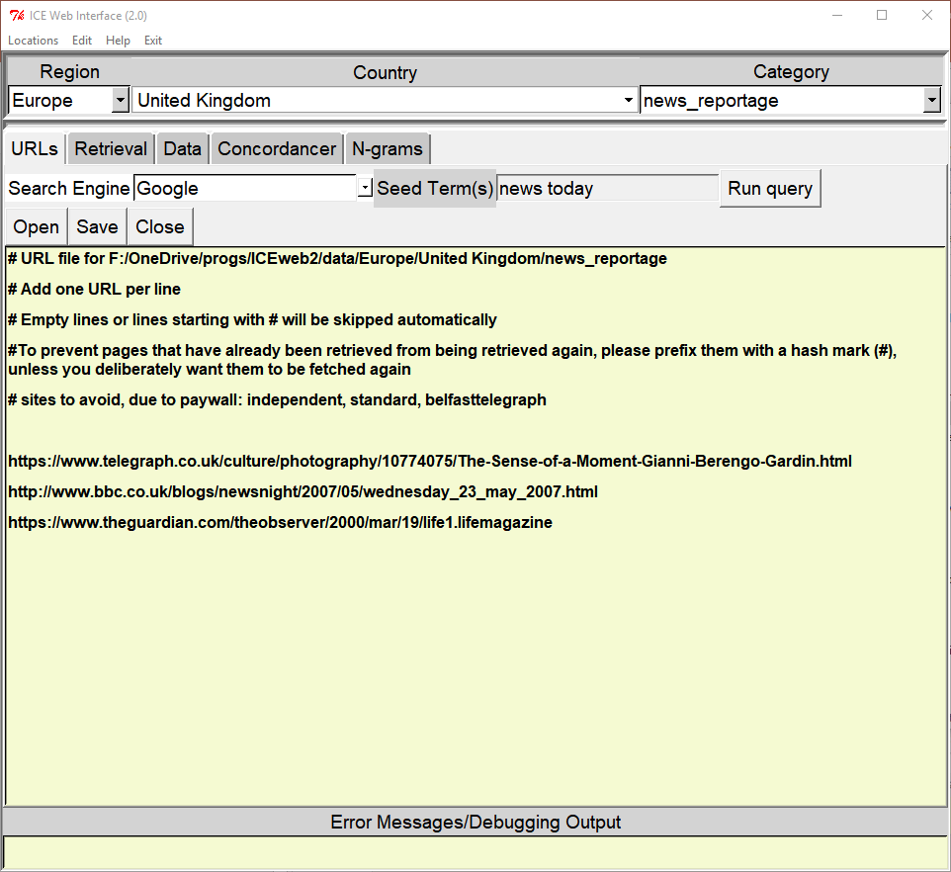
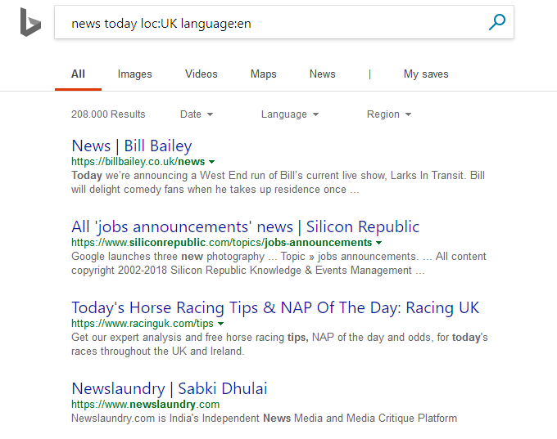
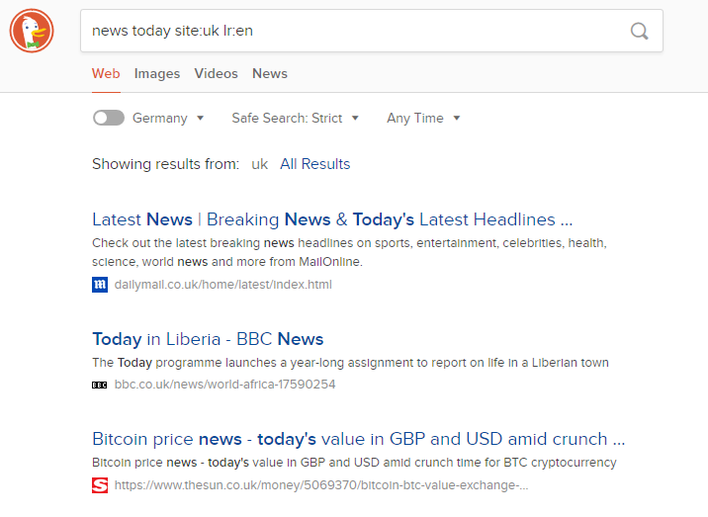
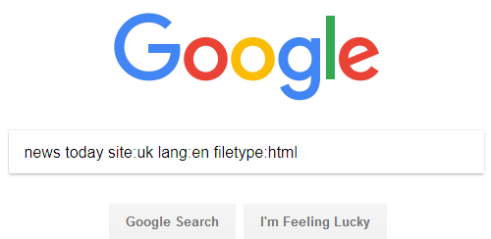
Details – Finding Suitable Pages
steps
  choose location & category
  select search engine
  choose seed terms
  launch browser + search engine
  collect URLs in URL editor
  save

Slide 8
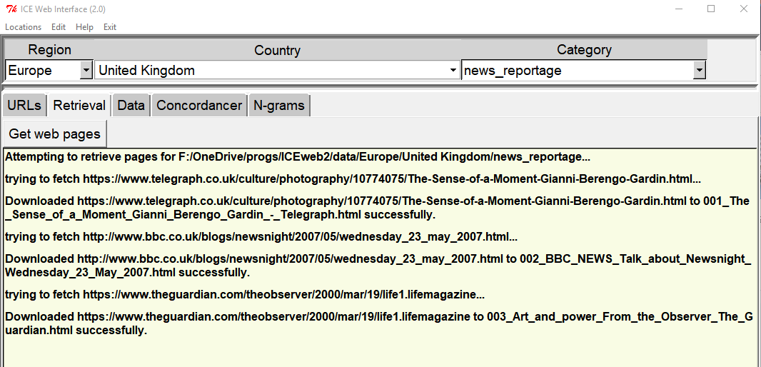
Details – Retrieval
steps
  switch to ‘Retrieval’ tab
  click ‘Get web pages’
  ICEweb attempts to retrieve URLS listed in URL file, reporting success or failure
  creates/appends to CSV file containing original title, URL, local filename, & download time

Slide 9
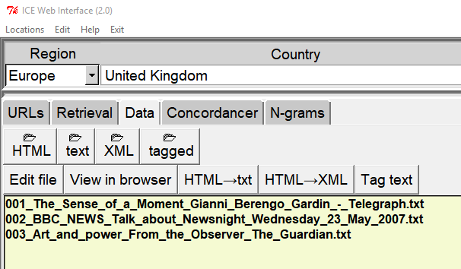
Details – working with data (1)
downloaded HTML can be converted to
  raw text
  XML (TART format)
  tagged text
files of a specific type can be
  listed via relevant folder button
  edited in built-in editor
  corresponding HTML viewed in browser

Slide 10
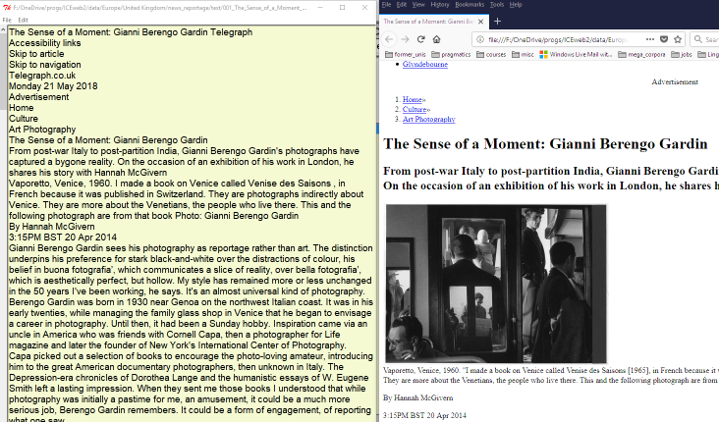
Details – working with data (2)
Text
Corresponding HTML

Slide 11
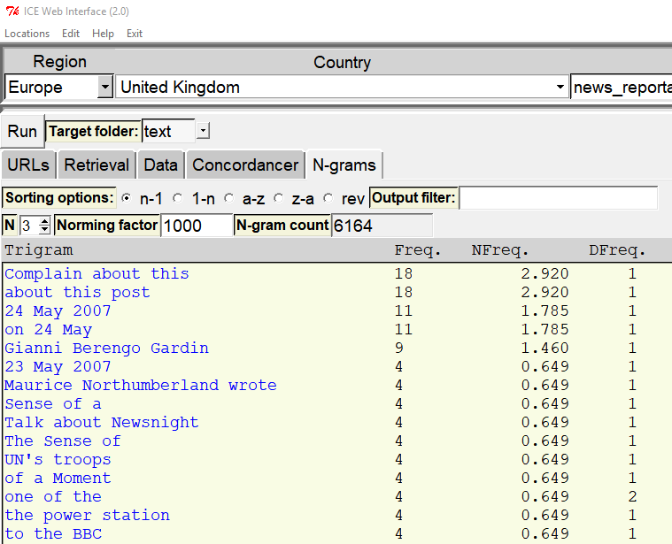
Details – N-gram analysis
options to produce wordlists or n-grams from raw text or XML
adjustable norming factor (default 1,000)
raw, normed & document frequency
output filterable via regex (e.g. ^[A-Z] → only n-grams starting with Proper names or sentence-initial)
hyperlinked n-gram triggers concordance

Slide 12
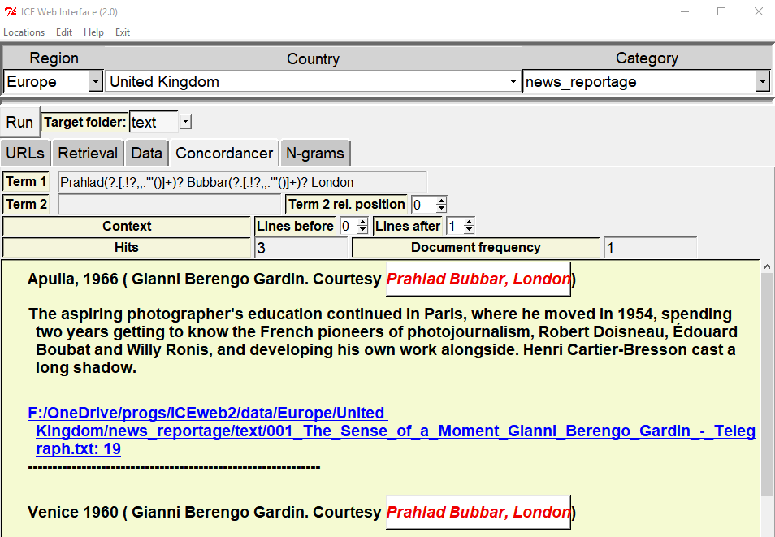
Details – Concordancing
line-based
2 search terms possible
adjustable context
  lines before/after
  relative position of second term
punctuation interpolated when triggered from n-grams tab
hyperlinked to editor

Slide 13
Questions or Suggestions?

