Slide 1
Automatically Enhancing Tagging Accuracy and Readability for Common Freeware Taggers
Martin Weisser
Center for Linguistics & Applied Linguistics
Guangdong University of Foreign Studies
weissermar@hotmail.com
http://martinweisser.org

Slide 2
Outline
Motivation
Typical freeware tagger output
Enhancing the readability of the tagset
Diversifying tag categories
Correcting probabilistic errors
The Tagging Optimiser
Conclusion

Slide 3
Motivation
PoS tagging an essential part of many linguistics projects
commercial taggers too costly for smaller-scale, non-funded, projects
freeware taggers useful, but with certain drawbacks
  usu. command-line based
  possibly difficult to set up/configure (e.g. setting classpath for Stanford Tagger)
  little control over existing GUIs
  tagset too limited for fine-grained grammatical analysis
  tagsets (somewhat) difficult to read/remember
  errors based on probabilistic approaches

Slide 4
Typical freeware tagger output
differences in tag assignment
Tagger | Stanford | Simple PoS Tagger | TagAnt (TreeTagger vertical format)
Word 1 | THE_DT | THE_DET | THE → DT → the
Word 2 | CLAIMS_VBZ | CLAIMS_VBZ | CLAIMS → NN → CLAIMS
Word 3 | OF_IN | OF_IN | OF → IN → of
Word 4 | A_DT | A_DET | A → DT → a
Word 5 | DOG_NN | DOG_NNP | DOG → NP → Dog
underscore format
tab format + lemma
slight differences in tag labels

Slide 5
Enhancing the readability of the tagset
traditional tags generally consist of 3-4 characters, usu. comprising
  first character for base category (e.g. N for nouns, V for verbs)
  additional characters for sub-specification (as applicable)
problems
  need to remember & expand sometimes complex abbreviations
  using initial as mnemonic for base category not always possible, due to overlap in initials (e.g A for article, adjective & adverb)
solutions
  expand base category names suitably → Adj, Adv, Noun, Verb
  mark sub-specification via ~, e.g. Adj~comp, Verb~modal
  generally facilitate expansion through longer abbreviations

Slide 6
Diversifying tag categories (1) – Issues
original Penn Treebank categories used by freeware taggers
  geared towards parsing
  hence minimalistic (48 tags only)
    few sub-distinctions
    conflation of categories, e.g. IN for prepositions & subordinating conjunctions
    13 ‘reserved’ for punctuation or special characters
less suitable for more fine-grained grammatical analyses
many useful distinctions, such as between coordinating and subordinating conjunctions, or subject and object pronouns, not present
suitability for tagging spoken language limited, e.g. interjections, discourse markers & response signals conflated under UH tag

Slide 7
Diversifying tag categories (2) – Solutions
distinguish between main categories
    conjunctions and prepositions
    to as Inf marker and preposition
    adjectives and ordinal numbers
distinguish between different sub-categories
  determiners: definite, indefinite, demonstrative
  verbs: BE-, DO- & HAVE-forms treated/marked differently from general verbs
  pronouns: include case roles as much as possible
mark discourse-relevant features more clearly, identifying
  discourse markers (DM)
  minimal yes-/no-responses (Resp~yes & Resp~no)
  interjections (Interj)

Slide 8
Correcting probabilistic errors (1) – reasons
according to Manning (2011)
  97% top accuracy generally reported = “token accuracy”
  in contrast, “sentence accuracy […] around 55–57%”
reasons to be found at different levels in tagger design/annotated training materials
  gaps in the lexicon
  unknown words
  errors where the tagger ought to plausibly be able to identify the right tag
  errors that may require more linguistic context
  underspecified or unclear tag examples
  incon­sistent or no standard
  wrong gold standard

Slide 9
Correcting probabilistic errors (2) – examples of corrections
our_PRPS hero_NN committed_VBN a_DET cardinal_NN sin_NN
committed_Verb~past
They_PRP disgust_NN and_CC please_VB us_PRP
disgust_Verb~not3s
the_DT pleasant_JJ trickle_VB of_IN Glenlivet_NNP Double_JJ Malt_NN
trickle_Noun~Sing
manhood_NN blighted_JJ with_IN unripe_NN di­sease_NN
blighted_Verb~ppart
and_CC that_IN glorious_JJ sound_NN which_WDT only_RB our_PRP$ British_JJ amateur_JJ choruses_NNS produce_VBP
that_Det~demSing

Slide 10
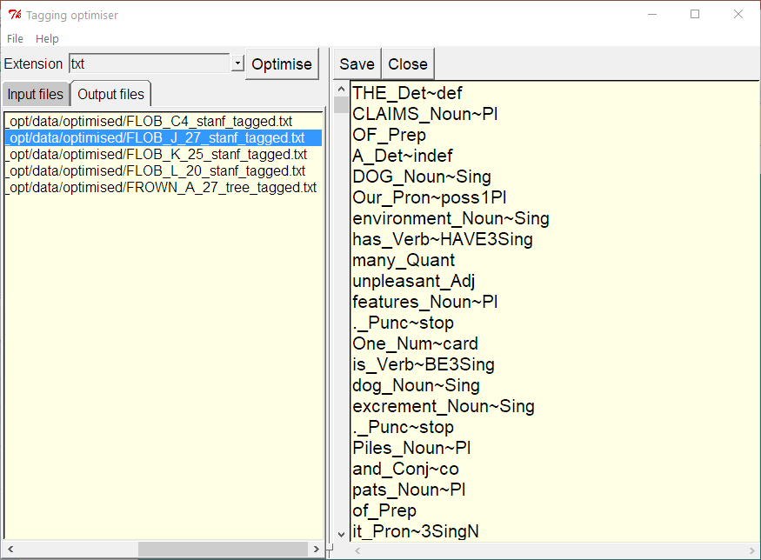
The Tagging Optimiser
extension selector
editor pane
I/O workspaces

Slide 11
Conclusion
first attempt at improving output, but room for improvement ☺ by
  making use of the best probabilistic freeware taggers have to offer
  diversifying tag categories further by establishing more contextual rules
  increasing tag precision by taking into account more contextual clues, e.g. for underspecified forms
need for community feedback on performance and suitability of tagset, perhaps working towards a new community standard
version 1.0 will be downloadable from http:/martinweisser.org/ling_soft.html#tagOpt by early October 2018

Slide 12
References
Anthony, L. (2015). TagAnt (Version 1.2.0) [Computer Software]. Tokyo, Japan: Waseda University. Available from http://www.antlab.sci.waseda.ac.jp/.
Fligelstone, S., Rayson, P., and Smith, N. (1996). Template analysis: bridging the gap between grammar and the lexicon. In J. Thomas & M. Short (Eds.). Using corpora for language research. London: Longman. 181–207.
Garside, R. and Smith, N. (1997). A hybrid grammatical tagger: CLAWS4. In R. Garside, G. Leech, & T. McEnery (Eds.) Corpus Annotation: Linguistic Information from Computer Text Corpora. London: Longman. 102–121.
Manning, C. (2011). Part-of-Speech Tagging from 97% to 100%: Is It Time for Some Linguistics? In A. Gelbukh (Ed.). Proceedings of the 12th international conference on Computational linguistics and intelligent text processing (CICLing’11). 171–189.
Ó Duibhín, C. (2017). Windows Interface for Tree Tagger. [Computer Software]. Available from http://www.smo.uhi.ac.uk/~oduibhin/oideasra/interfaces/winttinterface.htm.
Schmid, H. (1994). Probabilistic Part-of-Speech Tagging Using Decision Trees. Proceedings of International Conference on New Methods in Language Processing, Manchester, UK.

